Slide 1
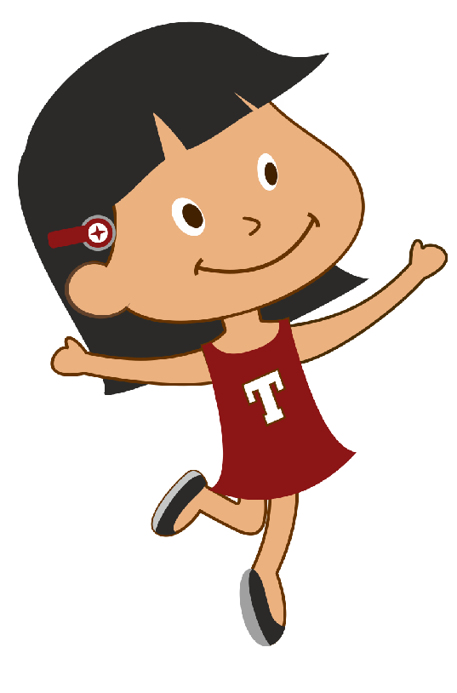


Hi I am tina
I want to learn the number 5.
Can you help me learn about the number 5?
Click on the play button to get started.
<Insert Header>
5 or Five

Slide 2

Lets learn the number 5
Lets take a look at this example.
In this example there are 5 apples
<Insert Header>
5 Apples
Five Apples

Slide 3

In this example there are 5 trees
<Insert Header>
5 Trees
Five Trees

Slide 4
Hi I am tina
I want to learn the number 5.
Can you help me learn about the number 5?
Click on the play button to get started.
<Insert Header>
5 or Five

Slide 5

<Insert Header>
Select the picture that 5objects

Slide 6


LKG MATH
Learn Number 5
Our questions
Which picture shows 5 (five) objects ?
Submit

Slide 7


LKG MATH
Learn Number 5
Our questions
Which picture shows 5 (five) objects ?
Submit

Slide 8


LKG MATH
Learn Number 5
Our questions
Which picture shows 5 (five) objects ?
Submit

Slide 9


LKG MATH
Learn Number 5
Our questions
Which picture shows 5 (five) objects ?
Submit

Slide 10


LKG MATH
Learn Number 5
Our questions
Which picture shows 5 (five) objects ?
Submit

Slide 11


LKG MATH
Learn Number 5
Our questions
Which picture shows 5 (five) objects ?
Submit

Slide 12


LKG MATH
Learn Number 5
Our questions
Which picture shows 5 (five) objects ?
Submit

Slide 13


LKG MATH
Learn Number 5
Our questions
Which picture shows 5 (five) objects ?
Submit

Slide 14


LKG MATH
Learn Number 5
Our questions
Which picture shows 5 (five) objects ?
Submit

Slide 15

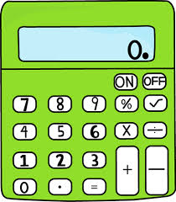
LKG MATH
Learn Number 5
Our questions
Which picture shows 5 (five) objects ?
Submit

Slide 16


LKG MATH
Learn Number 5
Our questions
Which picture shows 5 (five) objects ?
Submit

